Slide 1
Class Scheduler using Genetic Algorithm
By-
Ankit Yadav
001271369
INFO6205_303

Slide 2
Problem Statement
Class scheduling is a classic NP complete problem which can be easily solved by using Genetic Algorithm.
We have to make a class schedule using the given constraints like available class rooms, professors, student group size, courses and available time slots.

Slide 3
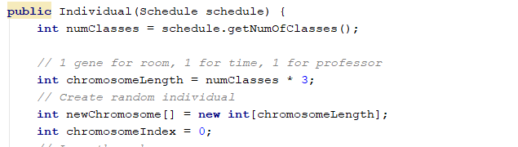
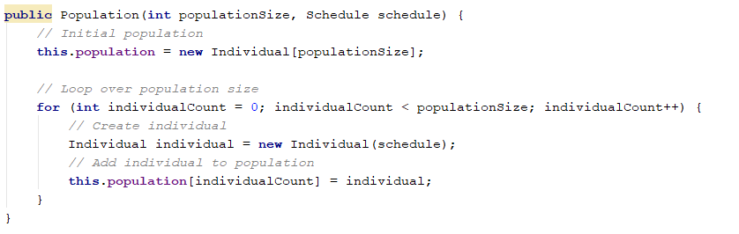
Implementation
Individual & Population
The genotype has been made up of room , timeslot and professor.
These 3 makes a class and the list of class makes a schedule.
The resulting schedule is our phenotype and then we check the conflict and assign fitness to the individual and the population.

Slide 4
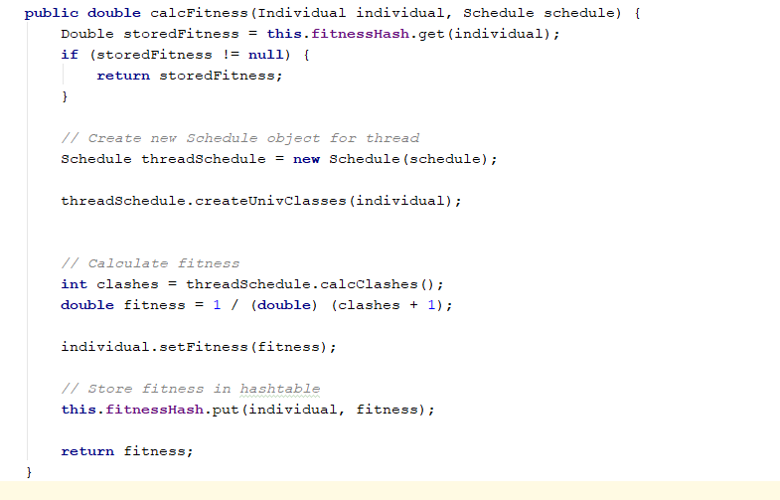
Genetic Algorithm
Fitness Function
The fitness is calculated of every individual with respect to the given schedule.
The calculate clash method and calculate class method are used in this respect.

Slide 5
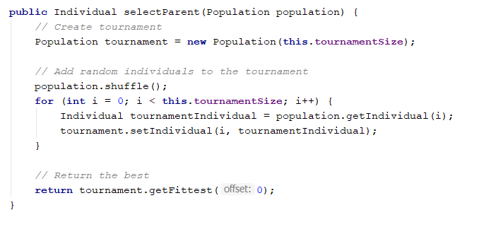
Genetic Algorithm- Contd.
Selection
The selection of parent for crossover was done by using tournament selection method.
After that cross over and mutation was applied to the resulting individual.

Slide 6
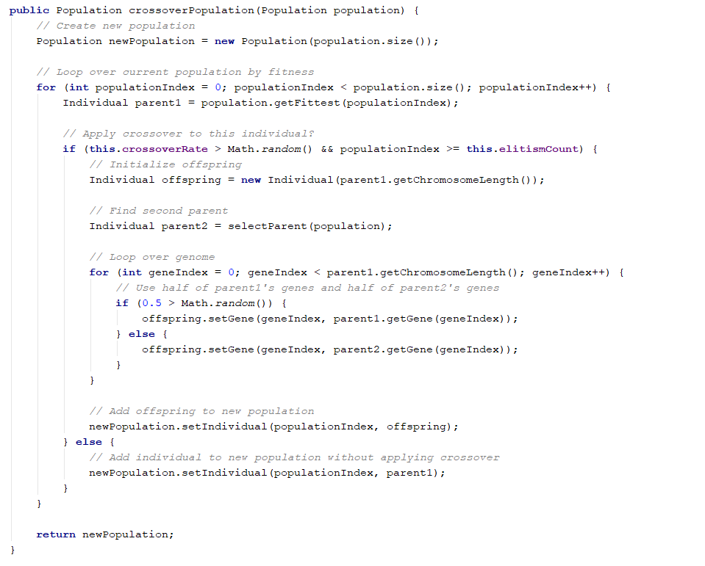
Genetic Algorithm- Contd.
Crossover
Crossover was done using uniform crossover technique on the selected individual. I have also used elitism count.

Slide 7
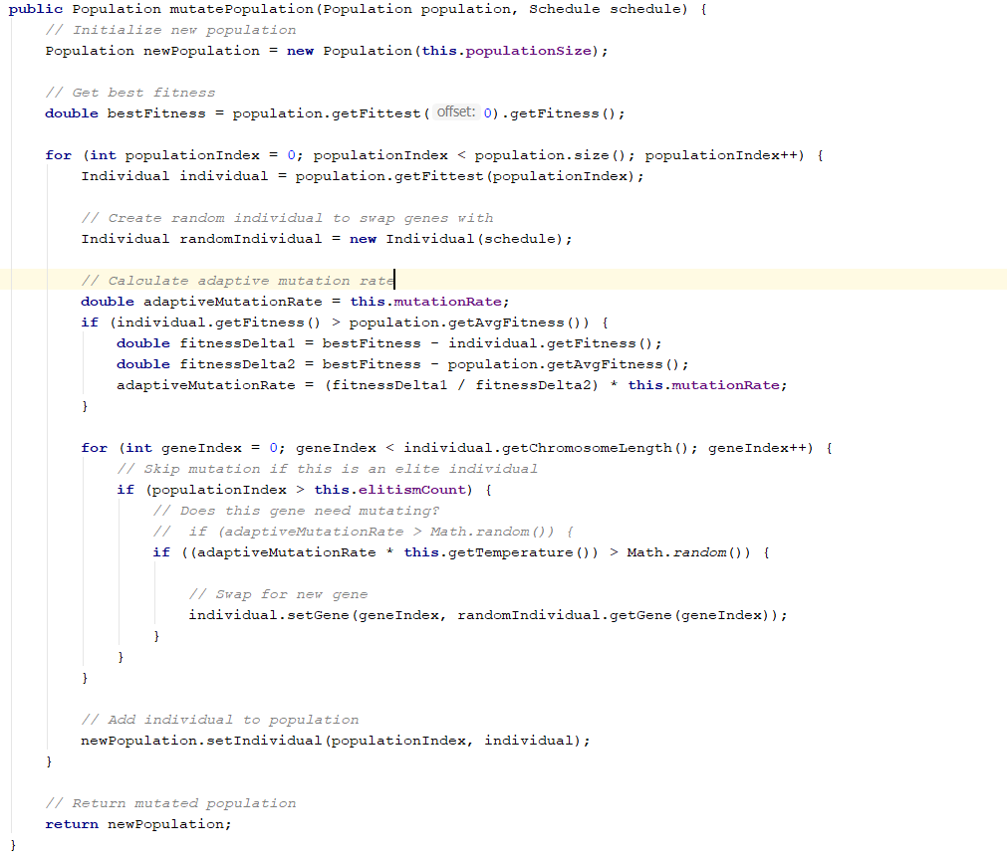
Genetic Algorithm- Contd.
Mutation

Slide 8
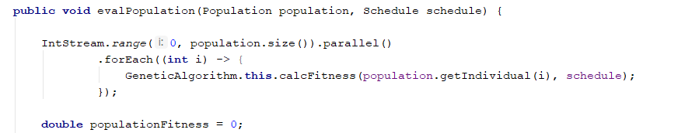
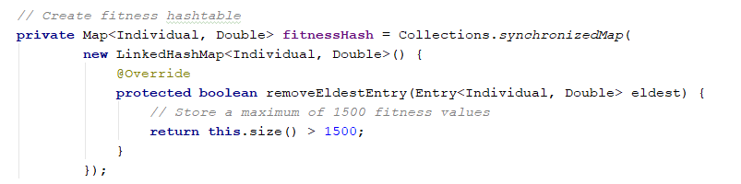
Optimization
Parallel Processing
This was achieved using IntStream functionality of java 8.
Hash Table
Hash table was used to store the values of fitness calculated so it helped in saving extra calculations fitness of same individual can be taken from hash table.

Slide 9
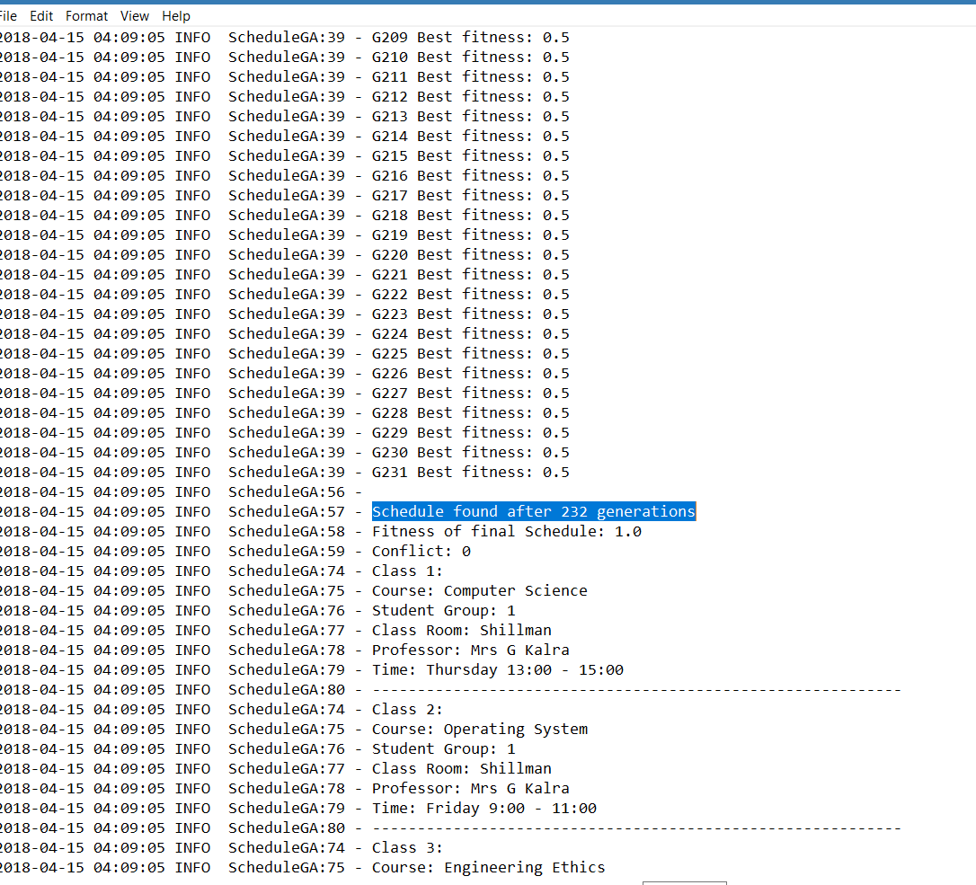
Program Output
The project was build in Maven using log4j for logging. So, the output is stored in the log file.

Slide 10
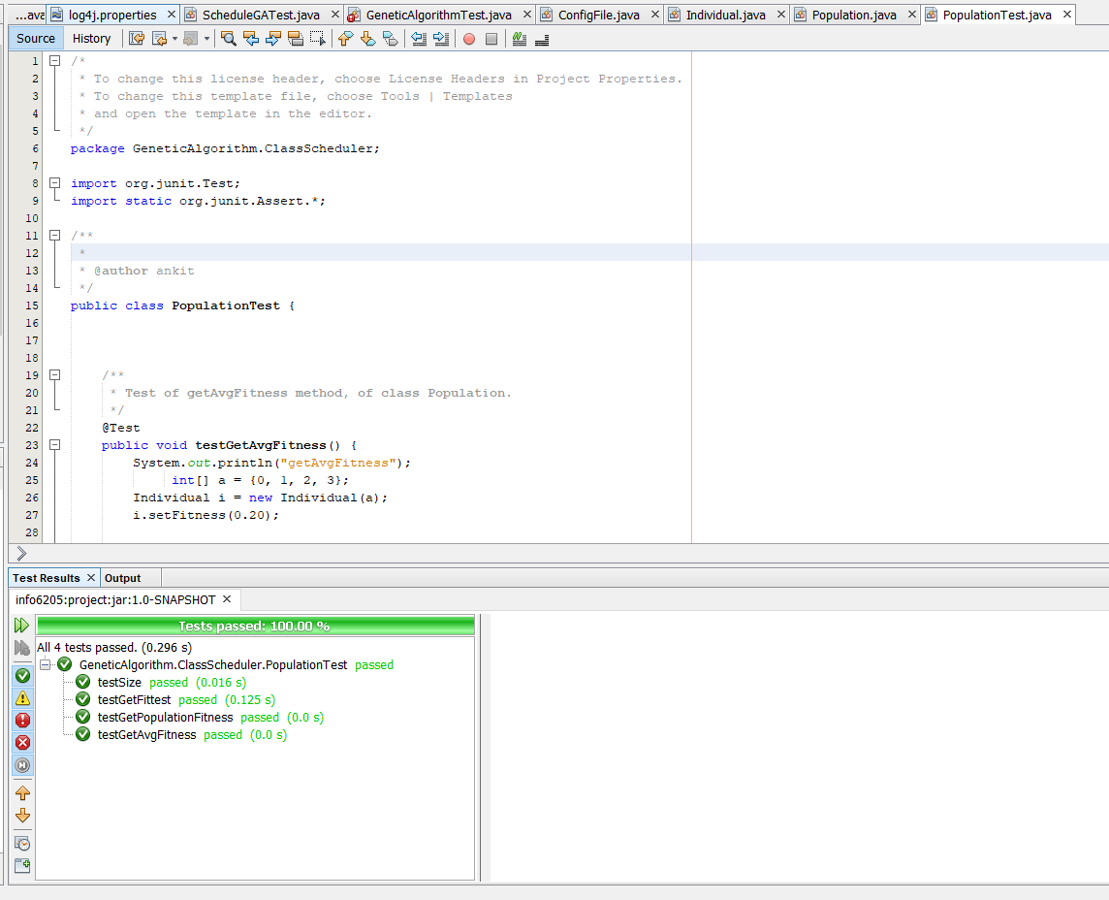
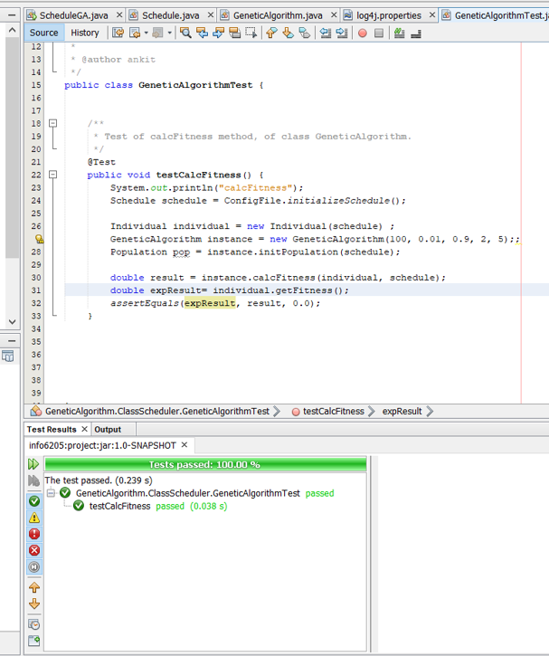
Test Case Passes
There were two test files and 5 test cases. The test were run on testing fitness function, getting fittest individual, getting average and population fitness.

Slide 11
Conclusion
One of the major different that Scheduling problem have over other NP complete problem like travelling salesman is that there can be many cases in which the algorithm did not give any solution.
For example, in travelling salesman each candidate solution is a solution even if not optimum one. But, in scheduling problem if the timeslot clashes then it is not an acceptable solution.
Scheduling implementation using Algorithm have huge application in various fields like operation research and production planning.

